Slide 1

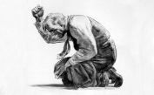
Death of a Salesman
The relative influences of Greek Tragedy and German Expressionism on it's form

Slide 2

Death of a Salesman
Death of a Salesman by Arthur Miller was first performed in 1949 on Broadway and was an immediate success. This deceptively simple story of the tragic road to suicide of a travelling salesman struck an emotional chord with American audiences. It was critically acclaimed and won the Pulitzer Prize and the New York Drama Critics Circle Award and the production ran for 742 performances before it closed. Since then Death of a Salesman has become one of the most performed and adapted plays in American theatrical history.

Slide 3
Death of a Salesman
Arthur Miller’s Death of a Salesman has become the American tragedy for the twentieth century. Written in 1949, this play is not the saga of noble kings from prominent families but instead the story of Willy Loman, the father of a middle-class family from Brooklyn. Willy, a sixty-three-year-old salesman, embodies a new type of tragic hero, and his family—devoted wife Linda and adult sons Biff and Happy—are the players who surround him on his last day on earth.

Slide 4
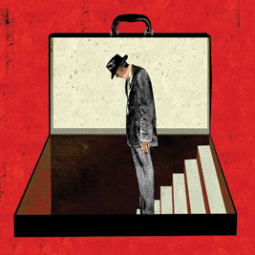
Greek Tragedy
Among the many influences on the writing of Arthur Miller was Greek drama. He admired the ritualistic aspect, the sense of form and symmetry of events. In Greek tragedy the individual is influenced strongly by forces outside of himself – his fate is foretold by oracles, and in many ways, the hero is not responsible for his actions. Our own perceptions of universal law and the role of the individual in society have changed such that this dramatic world view would not currently work.

Slide 5
Greek Tragedy
Miller was interested in developing a form which would function in the same kind of relationship to the moral crises of the twentieth (and twenty-first…) century as did Greek, Shakespearean or any other tragic drama – each to its own era. In his view, the best drama is social drama, that is, drama which illuminates the ties between the individual and society. As in Greek tragedy, there are forces beyond us that determine our fate, but our own will as well as the events of our own past, are called into play at all times.

Slide 6
Greek Tragedy
There is much discussion of whether Death of a Salesman can be considered a tragedy. ‘Tragedy’ as a form was defined by the Greek playwright Aristotle in 330 BCE. He defined a tragic character as being:
A person of noble stature who has a fatal flaw (often arrogance or over-confidence) that leads to his or her downfall. The suffering is not wholly deserved and through that suffering, the character gains some selfawareness that turns his or her defeat into a sort of triumph. The play should not leave the audience feeling depressed but rather with a sense of compassion and awe.
If we go by this definition, Willy fulfils most of the qualifications – except that he is not a man of high status.

Slide 7
Greek Tragedy
Miller answered this criticism by saying that “I believe that the common man is as apt a subject for tragedy in its highest sense as kings were… If rank or nobility of character was indispensable, then it would follow that the problems of those with rank where the particular problems of tragedy”.
Certainly, the play follows much of the structure of a tragedy as Willy is unavoidably drawn to his destruction by his inability to see the truth (his ‘fatal flaw’).

Slide 8
Greek Tragedy
Critics have hotly debated the questions of whether Willy is a tragic hero or whether Death of a Salesman is a tragedy. Dramatic tragedy was invented and defined by the Greeks. Aristotle said a play has to have four elements to qualify as a tragedy: 1) noble or impressive characters; 2) the main character's discovery or recognition of a truth about himself; 3) poetic language; and 4) the ability to arouse and then soothe the audience's pity and fear. Some critics consider that Death of a Salesman is debatable on all four elements, while others think the play meets all these criteria.

Slide 9
Greek Tragedy
Arthur Miller argued that times have changed- we no longer live in an era dominated by kings and queens- and so maybe our definition of tragedy should change, too.
Though he is a common man- Low-man- Willy was later described by the author who created him as "a very brave spirit who cannot settle for half but must pursue his dream of himself to the end." Though Willy did not have great intellectual powers, Miller claims he did have a self-awareness- otherwise he would not have killed himself when he realized his life was meaningless.

Slide 10
Greek Tragedy
The difference between Willy and his salesman neighbor Charley is that Willy is intense and passionate and cares about his dream enough to sacrifice his life to it. A tragic hero is someone with the dedication to die for a belief, but also someone who has a tragic flaw or limitation that defines him as a character and makes the tragedy happen. He has alternatives, but he chooses to live in a certain way that brings about his downfall. All of this is true of Willy.

Slide 11
Greek Tragedy
As soon as Death of a Salesman opened, critics began writing about its relation to Greek tragedy, usually pointing out that Willy doesn't qualify as a tragic hero. Without mentioning his critics, Miller replied with an essay titled "Tragedy and the Common Man." Death of a Salesman does have a shattering emotional impact that corresponds to that of a Greek tragedy. There are some other similarities- the inevitable movement toward death of the protagonist (or central character) with growing self-awareness, the single story without subplots, the unity of time (Death of a Salesman takes place within the course of about twenty-four hours) but they are of limited significance.

Slide 12
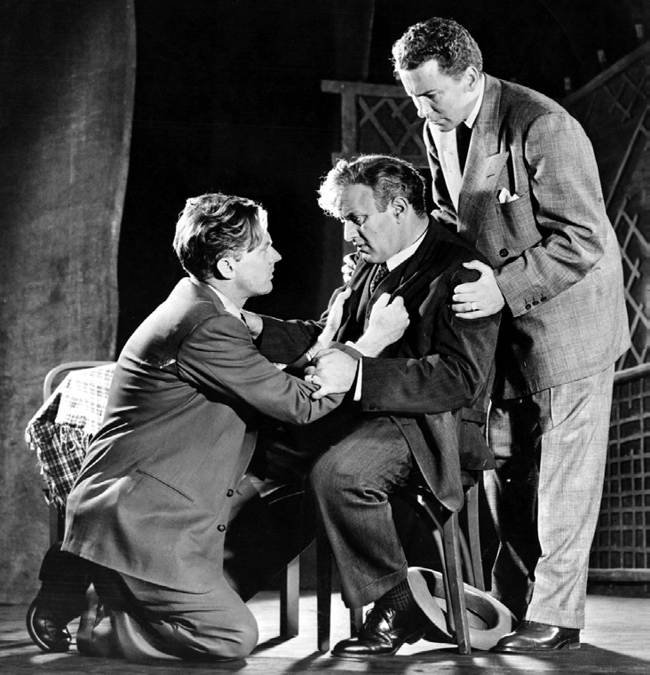
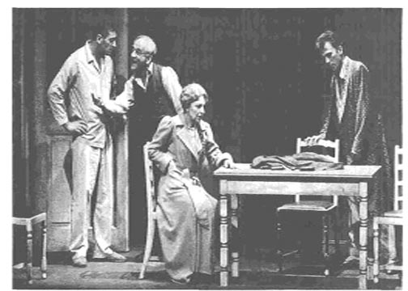
Greek Tragedy
Is Death Of a Salesman a Greek Tragedy?

Slide 13
Greek Tragedy
The elements in Death of a Salesman that mark it as a tragedy are the ever declining fortunes of the hero and the ultimate demise of the hero. Elements that are contradictory of an Aristotelian Greek tragedy are that Willy Loman is a common man, a man of the people, and has no superior qualities by which to intensify the degree to which the audience can identify with and pity him, nor is the subject matter of a high "serious" nature; it too is commonplace.

Slide 14
Greek Tragedy
Willy Loman seems to incorporate all these eras in that he is just a random man on the wheel of fortune without being particularly sympathetic to a broad audience who feel like they could--or wanted to--identify with him. Willy's fortunes turn on him as a man on the wheel of fortune...and he dies. His death offers a perverse parallel to the Greek resolution of tragedy in that the fallen hero would often learn something or become a better man. In Death of a Salesman, Willy's death liberates and frees his family because his insurance money pays off the house.

Slide 15

German EXPRESSIONISM
Expressionism was a cultural movement, initially in poetry and painting, originating in Germany at the start of the 20th century. Its typical trait is to present the world under an utterly subjective perspective, violently distorting it to obtain an emotional effect and vividly transmit personal moods and ideas. Expressionist artists sought to express the meaning of "being alive" and emotional experience rather than physical reality.

Slide 16
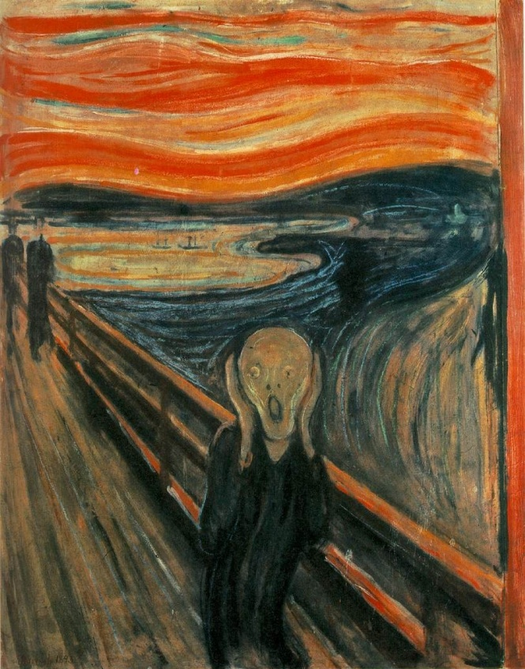
German EXPRESSIONISM
The Scream by Edvard Munch

Slide 17
German EXPRESSIONISM
In the theatre, there was a concentrated Expressionist movement in early 20th century German theatre of which Georg Kaiser and Ernst Toller were the most famous playwrights.
Expressionist plays often dramatize the spiritual awakening and sufferings of their protagonists.
Expressionism is a movement in drama and theatre that developed in Europe in the early decades of the 20th century and later in the United States. It forms part of the broader movement of Expressionism in the arts.

Slide 18
German EXPRESSIONISM
Literary style which, like expressionism in art, attempts to portray the inner workings of a person's mind by, effectively, turning them ‘inside out’ and allowing mental states to shape their face, body, and even the world in which they live. In theatre, expressionism results in a drama of social protest, in which representation of the outer world took second place to the inner turmoil experienced by the main character, which is expressed via long monologues.

Slide 19
German EXPRESSIONISM
In the USA, a strong expressionist influence can be traced in the plays of Eugene O'Neill, Elmer Rice, Tennessee Williams, and Arthur Miller.
expressionist drama disgust with materialistic society was combined with a sense of foreboding of its imminent collapse.

Slide 20
German EXPRESSIONISM
In expressionist literature, the physical consequences of a distorted situation are followed through as if it were completely real. Expressionist writers divide over the final consequences of this. Personal tragedies usually end in the destruction of the character. However, when the focus is the state of society a positive ending can result, with the victory of traditional human values over repression and mass production.

Slide 21
German EXPRESSIONISM
To achieve the thematic ends of his play, Arthur Miller used expressionism throughout Death of a Salesman. This expressionism was used in various ways, including showing the break-up of the Loman family, as well as the destruction of the father, Willy. This mode of narrative development made the plot more interesting and intrigued the audience to find out more.

Slide 22
German EXPRESSIONISM
Expressionism is used as an attempt to dramatize the reality that is seen by an individual's mind. It is a term applied to an artistic trend from the twentieth century. Miller used this exact method in his play Death of a Salesman. To achieve the expressionism, memory scenes were used throughout the play. These shifts between time and setting revealed many facts about Willy, such as his thoughts, attitudes, and beliefs.

Slide 23
German EXPRESSIONISM
More important for an understanding of the form of Death of a Salesman is a familiarity with German expressionism. Expressionism sought to depict the inner life of characters. It went further than realism or naturalism, which traced the lineal development of a story through external details of environment. Expressionism used symbols to evoke the unseen and the unconscious, and so expressionist plays were "cool" in their approach: objective, stylized, impersonal.

Slide 24
German EXPRESSIONISM
The incidents from the past that Willy recalls in the present are an "expression," or dramatization, of what's going on inside Willy's mind. An observer in the present would simply see Willy talking, mumbling to himself. Our witnessing those recollected episodes lets us experience Willy's process of thought.

Slide 25

عبير السريحي
هند الغامدي
هنادي أبو عصيدة
عهود الجحدلي
نهلة القحطاني

